Slide 1
Deaths during or following police contact
Statistics for England and Wales 2020/21
29 July 2021

Slide 2
This report presents figures on deaths during or following police contact that happened between 1 April 2020 and 31 March 2021. It provides a definitive set of figures for England and Wales, and an overview of the nature and circumstances in which these deaths occurred.
It is the seventeenth in a series of statistical reports on this subject, published annually by the IOPC, formerly the Independent Police Complaints Commission (IPCC).
> Introduction

Slide 3
> Introduction
To produce these statistics, we examine the circumstances of all deaths that are referred to us. We decide whether the deaths meet the criteria for inclusion in this report under one of the following categories:
deaths in or following police custody
fatal shootings
road traffic fatalities
apparent suicides following police custody
other deaths following police contact that were subject to an independent investigation
Notes:
Police forces have a statutory duty to refer all incidents involving a death or serious injury to us.
This report is part of our statutory remit and highlights the importance of having in place robust systems of investigation, learning and accountability, which follow deaths following contact with police

Slide 4
> National statistics The UK Statistics Authority has designated these statistics as National Statistics. This designation means that the statistics: > meet identified user needs > are well explained and readily accessible > are produced according to sound methods > are managed impartially and objectively in the public interest

Slide 5
> Overall findings
During 2019/20, in each category there were:
19 deaths in or following police custody
1 police shootings
25 road traffic fatalities
54 apparent suicides following custody
92 deaths following police contact that were independently investigated
The number of deaths in or following custody has remained in line with recent years – an increase of one from last year.

Slide 6
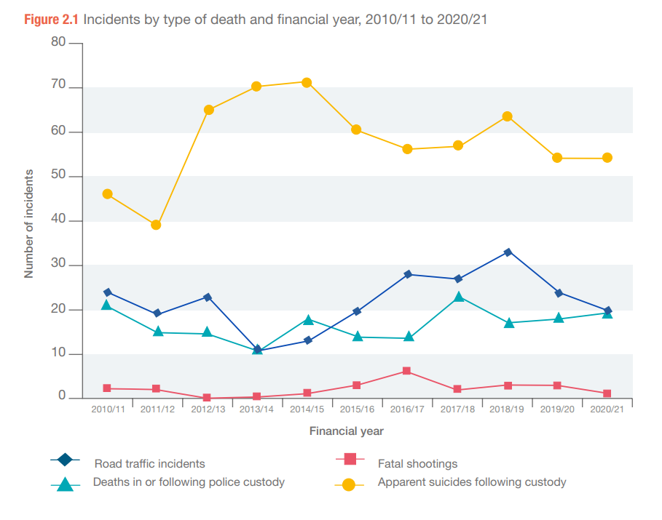
Notes:
This graph shows the change in numbers to incidents by type of death from 2009/10 to 2019/20. We will explore this further as we go through the next few slides.

Slide 7
> Key findings
Deaths in or following police custody
This year there were 19 deaths in or following police custody. This is a slight increase on the 18 deaths in 2019/20 but remains in-line with the average figure for over the last decade.
Twelve people had some force used against them by officers or by members of the public before their deaths, although the use of force did not necessarily contribute to their death.
Of the 19 deaths in or following police custody, seventeen people were White, and two were Black.
Three deaths took place within a police custody suite. There were no apparent suicides while in a police custody suite. There was one death that was a suicide but the act took place prior to arrest.
Notes:
Between 2004/05 and 2008/09, there was a year-on-year reduction in the number of deaths in or following police custody. These deaths reduced from 36 in 2004/05 to 15 deaths in 2008/09. Over the next two years, the number of deaths in custody increased to 21 in 2010/11, before reducing to 15 in 2011/12 and 2012/13. There was a further reduction, to 11, in 2013/14.
In 2014/15, the number rose again to 18 and then declined and remained stable at 14 in 2015/16 and 2016/17. In 2017/18 there were 23 fatalities, the highest number recorded for ten years. This number fell to 17 fatalities in 2018/19 and rose to 18 in 2019/20.
This year, no one died after making an apparent suicide attempt while in a police custody suite. The last incident of this kind was in 2016/17. Before that, there was one incident in 2014/15 and one in 2008/09. Since 2004/05, a total of seven people are known to have died as a result of self-inflicted acts while in a police cell.
This year three people were pronounced dead in a police cell. In 2019/20 one person died in a police cell. In 2018/19 no-one died in a police cell. In 2017/18 there were three such deaths.

Slide 8
> Key findings
Alcohol, drugs and mental health
As in previous years, mental health and links to drugs or alcohol were common factors amongst many of those who died:
12 of the 19 people who died in or following police custody had mental health concerns.
14 people who died in or following police custody had links to drugs and/or alcohol.
Over half (48) of those who died following other police contact were reported to be intoxicated with drugs and/or alcohol at the time of the incident, or it featured heavily in their lifestyle. Over two-thirds (62) were reported to have mental health concerns.
26 fatalities following other police contact related to concern about a person’s risk of self-harm, suicide, or their mental health. There were a further 13 people who were reported missing to the police with a specific risk of self-harm or suicide.
Notes:
It’s critical that police are properly trained and equipped to manage the challenges they inevitably face, that they are able to recognise vulnerability and act swiftly to manage the risks.
But the issues are wider than the police service – they are dealing with vulnerable people whose needs and risks have not been adequately managed in the community.
Ultimately to prevent further deaths and harm, we must look beyond policing and redirect resources into community, health, welfare and specialist services.

Slide 9
> Key findings
Use of force
Twelve of the 19 people who died in or following police custody had been restrained by the police or others before their deaths. There were nine (out of the 92) ‘other deaths following police contact’ that involved restraint or other use of force. The use of force did not necessarily contribute to the death.
Of the deaths in or following custody where restraint was used, eleven were White and one was Black.
Of the nine ‘other contact deaths’, seven involved restraint by the police; two of the deceased were Black and two were Asian.

Slide 10
> Key findings
Shootings
This year there was one fatal shooting. The deceased was White and the incident is subject to an ongoing independent investigation.
This is down on the three shootings in 2019/20 and is the lowest figure since 2014/15, when there was one shooting.

Slide 11
> Key findings
Road traffic incidents
This year there were 20 fatal police-related road traffic incidents (RTIs), resulting in 25 fatalities. The number of fatal RTI incidents last year was 24. While this figure has fluctuated over the past 11 years, this year’s figure represents the fifth lowest number recorded over the 17-year period since 2004/05, when these statistics were first published.
There was a slight rise in fatalities this year (25 in 2020/21 up from 24 in 2019/20). These figures are subject to fluctuation and therefore caution should be taken when making year-on-year comparisons.
Of the 25 fatalities, 20 resulted from pursuit-related activity. The number of pursuit-related fatalities has slightly increased this year but remains in line with the average seen over previous years.
This year there were three pursuit-related incidents that resulted in multiple fatalities (three incidents accounted for eight fatalities)

Slide 12
> Key findings
Road traffic incidents
Of the 20 pursuit-related fatalities – sixteen were the driver or passenger in the pursued vehicle, three people were pedestrians who were hit by the pursued or suspect vehicle and one was in an unrelated vehicle hit by the car being pursued.
There was one emergency response related incident and fatality. This is a decrease compared to the three recorded last year. It is the lowest number of emergency response-related incidents and fatalities recorded since 2016/17 when there were zero.
There were 4 ‘other’ police traffic activity incidents and fatalities. Two incidents happened while the police were on routine patrol or driving duties and two happened when a vehicle responded to the presence of the police.
The average age of the people who died was 28. This decreases to 23 if the deceased was the driver or passenger in the pursued or fleeing vehicle. It increases to 46 if the deceased was a pedestrian, cyclist or a driver or passenger in a vehicle hit by either the police or the pursued or a fleeing vehicle.

Slide 13
> Key findings
Apparent suicides following police custody
The number of recorded apparent suicides following custody was 54, the same as the 54 recorded in 2019/20. This is the lowest figure recorded since 2012/13 when there was a notable increase in this category. However, the number still remains higher than the average before 2012/13.
Twenty-six (48%) of those who died had been arrested for an alleged sexual offence – of these, 21 (39%) involved offences against children. These proportions are higher than the figures recorded last year (30% and 22% respectively) and higher than average figures.
Notes:
Apparent suicides following time in police custody are included if they take place within two days of the person’s release from custody. They are also included if experiences in custody may have been relevant to the death, and the death has been referred to us. The police may not always be told about an apparent suicide that happens after detention in custody, as the association may not be clear. Therefore, there may be more deaths in these circumstances than are reported here.

Slide 14
> Key findings
Other deaths following police contact – independent only
The IOPC independently investigated the deaths of 92 people who died during or following other contact with the police, a decrease from 107 in 2019/20. This is the third consecutive year that the reported number of deaths in this category has decreased.
The number of deaths that will be recorded in this category is directly impacted by our approach to conducting independent investigations, as inclusion into the annual statistical report is based on there being one. Any change in this category does not, therefore, necessarily indicate an increase or decrease in the number of people who have died following some form of contact with the police.
Notes:
In 2010/11, a change was made to the definition of this category. It now includes only those deaths following police contact that were investigated independently by the IOPC, previously the IPCC.
During 2014/15, the IPCC started a significant period of change and expansion in response to the then Home Secretary’s announcement that there should be more independent investigations into serious and sensitive matters. This had a direct impact on the number of deaths we recorded in the ‘other deaths following police contact’ category because inclusion of this type of case in this annual report is based on them being independently investigated. Any increase in this category does not, therefore, necessarily indicate an increase in the number of people who have died following some form of contact with the police.
In 2018/19 the IOPC began a phased move to thematic case selection.
The thematic areas include domestic abuse, RTIs, abuse of authority for sexual or financial gain, mental health, near misses in custody and discrimination. Thematic case selection involves independently investigating more cases where these themes may be a factor. This will enable us to develop a body of evidence for learning and prevention work. The move to thematic case selection may have an impact on the number and proportion of cases involving particular circumstances of death – such as concerns for welfare based on mental health, or domestic-related incidents.

Slide 15
> Key findings
Other deaths following police contact – independents only
86 fatalities followed contact with the police, either directly or indirectly, after concerns were raised about someone’s welfare – of these, 21 related to a report of a missing person. The police generally did not have direct contact with the deceased in these circumstances. Of these 21 people, 13 people were also identified as at risk of self-harm or suicide.
Of these 86 fatalities, 21 were linked to concerns that were domestic related. Women accounted for a higher proportion in this contact type than they did in the other deaths in or following police contact categories that were investigated independently.

Slide 16
> Key findings
Other deaths following police contact – independents only
During 2020/21, just over a quarter of investigations into deaths following police contact related to incidents where someone had reported being concerned about a person’s risk of self-harm, risk of suicide, or mental health, a similar proportion to 2019/20. Over a fifth of investigations into deaths following police contact were domestic-related. These two types of concern for welfare are both linked to current thematic work areas. This may result in the number of these types of investigations increasing and/or forming a larger proportion of the ‘other contact’ deaths that the IOPC independently investigates.

Slide 17
> To find out more
The full report is available on our website.
If you have difficulties accessing the report please email, content_design_team@policeconduct.gov.uk
For any questions or comments about the report or the statistics please email, research@policeconduct.gov.uk
Website: www.policeconduct.gov.uk
Twitter: @policeconduct
Email: enquiries@policeconduct.gov.uk
Phone: 0300 020 0096
Text relay: 18001 0207 166 3000

