Slide 1
> Insert front cover graphic
Text goes here

Slide 2
> Who we are and what we do
We oversee the police complaints system in England and Wales:
investigate the most serious incidents and complaints about the police
consider applications for review or appeal from people who are unhappy about the outcome or handling of their complaint
set and monitor the standards that police should use to handle complaints
publish research and statistics on specific areas of policing and the complaints system
use learning from our work to influence changes in policing
All our decisions are made independently of the police, government and interest groups.

Slide 3
> Title
Text goes here

Slide 4
> Title
Text goes here

Slide 5
> Title
Text goes here

Slide 6
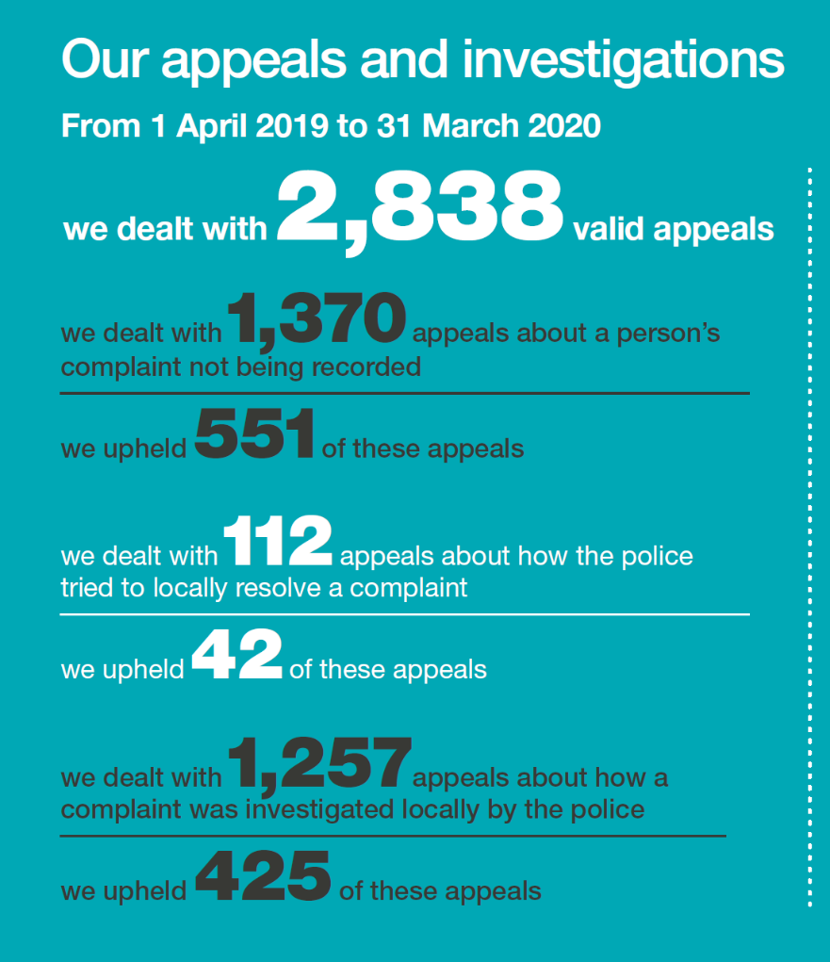
> Our work on appeals/reviews

Slide 7
> Improving timeliness across the system
We’re redesigning our investigations to make them more efficient and effective. This will be informed by best practice and input from stakeholders.
We reduced the time our investigations take by:
piloting a new investigation model on quick-time decision making and early engagement with police – being evaluated for national rollout
making changes to procure evidence more quickly by identifying and engaging experts
working with the Police Federation and others to improve understanding of our role – resulting in increased co-operation with investigations, earlier statements and interviews

Slide 8
> Improving timeliness
We’ve made strong progress:
completed 718 independent investigations
35% of independent investigations completed within 6 months
83% of independent investigations completed within 12 months
reduced open independent investigations from 548 to 327
two thirds of our open caseload were less than six months old

Slide 9
> Helping to deliver reforms to the system
New reforms introduced from 1 February 2020 to help simplify the complaints system, making it easier to navigate and ensuring that complaints are dealt with more quickly and effectively.
The reforms gave us new powers, including the power to investigate without a referral from the relevant police force and to present our own cases at police misconduct hearings.
We also helped implement the reforms by:
publishing statutory guidance to help forces and police and crime commissioners (PCCs) comply with new laws
helping the National Police Chiefs’ Council’s working group develop new Reflective Practice Review process
holding 13 events to support police forces and PCCs to understand and apply the new laws
worked with policing bodies to produce resources promoting the new reforms
published information for complaint handlers on specific topics

Slide 10
> Examples of change

Slide 11
> Title
Text goes here

Slide 13
> Organisational learning
In 2019/20, we:
Of these, 90 were to local police forces, 81 were about policy or guidance and 19 about training for police officers and staff.

Slide 14
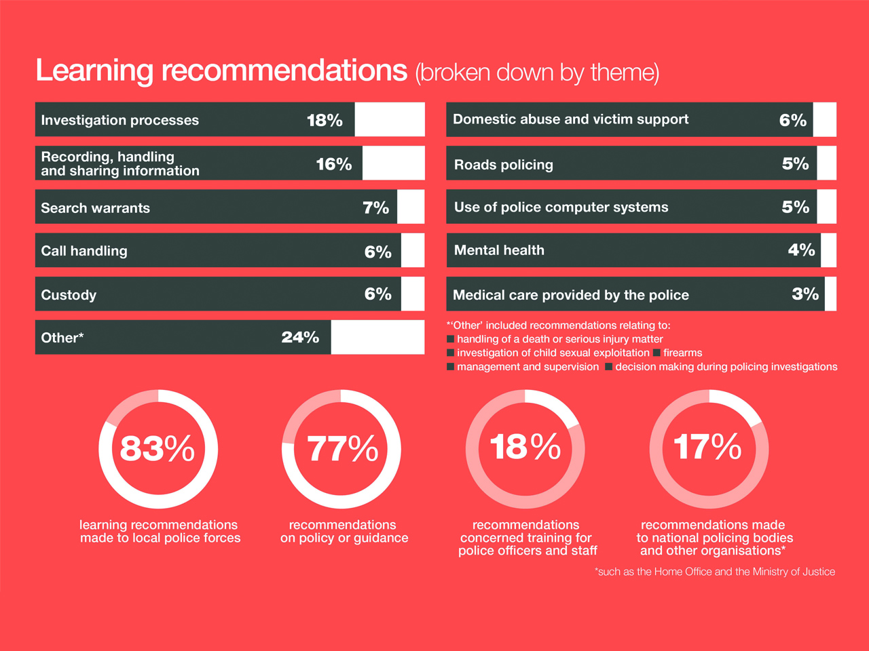
> Title
Text goes here

Slide 15
> Learning the Lessons magazine for forces
Learning the Lessons supports police forces to improve their policy and practice.
Provides real-life case studies and questions to prompt readers to make changes
We published three issues on custody, missing people and young people
Around 1,000 people receive hard copies of each issue, with over 5,000 website downloads each
“[Learning the Lessons] helps make our training packages appropriate to the risks and situations that are current...being the lead for custody first aid training it keeps me up to date and informed on the issues and events happening in custody nationally and I adapt my training packages around these topics.”
Anonymous reader feedback on Learning the Lessons, custody issue

Slide 16
> Title
Text goes here

Slide 17
> Title
Text goes here

Slide 18
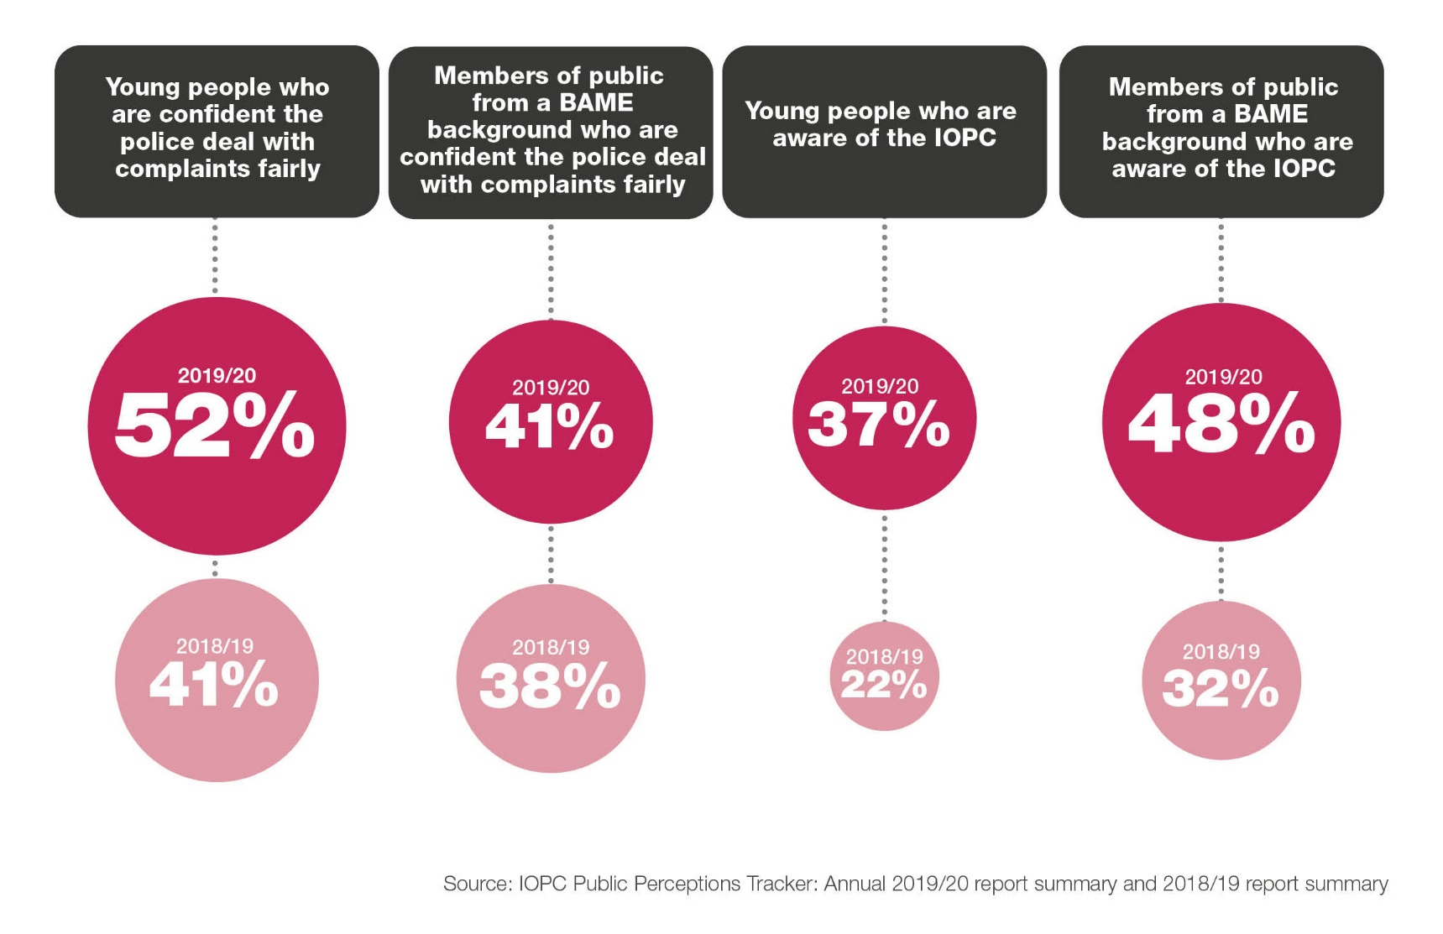
> Building awareness of IOPC and confidence in police complaints

Slide 19
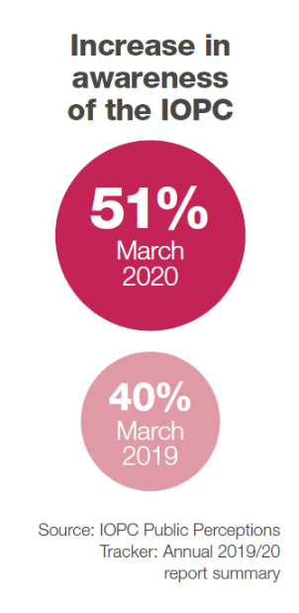
> Raising awareness
To increase awareness we:
proactively provided information to the media
shared information via social media
published newsletters, reports and publications
held several outreach events with local communities
Publishing information provides transparency on serious complaints - including what police forces can learn from them.
Notes:
.

Slide 20
> Title
Text goes here

Slide 21
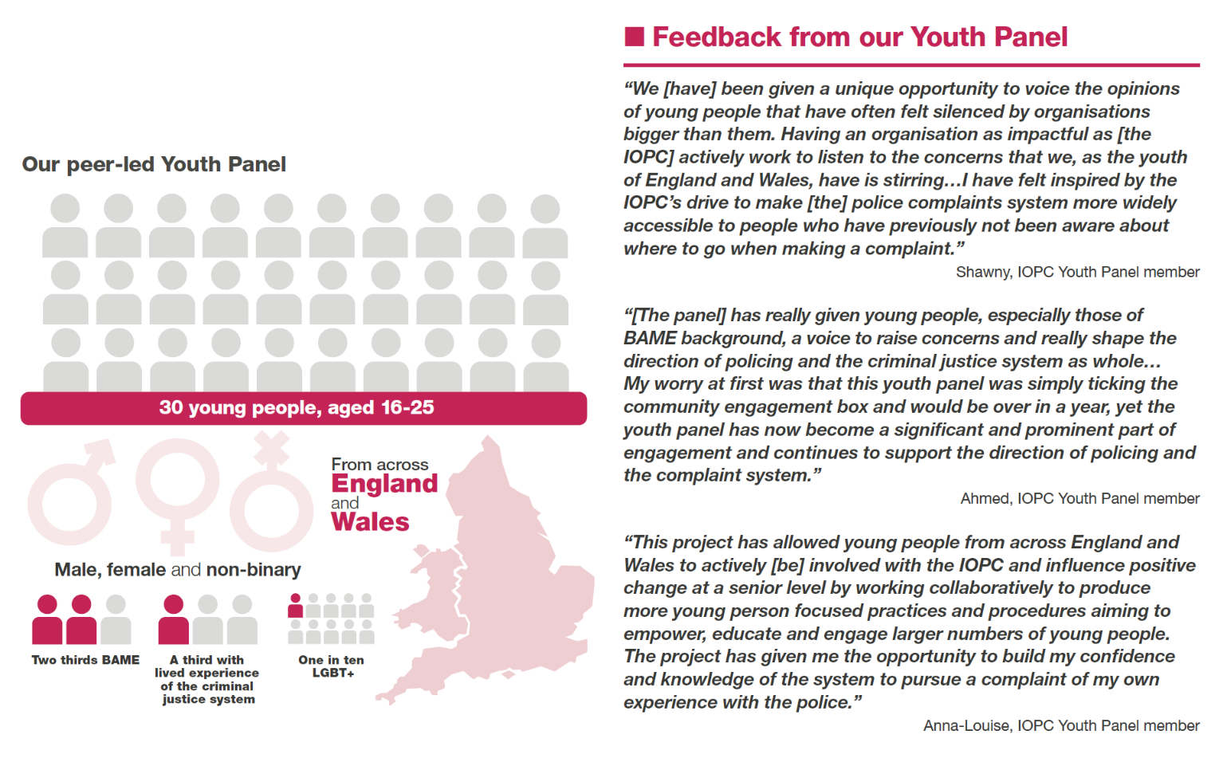
> Working with young people

Slide 22
> Working with others
Our Youth Panel:
talked about their experiences of policing with national policing leaders
guest edited a youth edition of Learning the Lessons
helped provide training to our Customer Contact Centre Staff
advised us on a high-profile stop and search investigation involving young people
developed a young person’s guide to the police complaints system

Slide 23
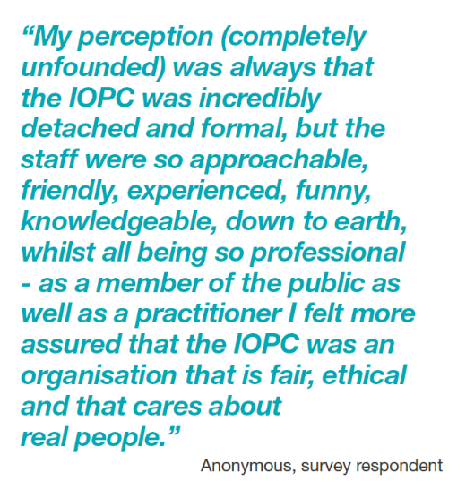
> Meeting the needs of our service users
We achieved Customer Service Excellence accreditation in March 2020
demonstrated compliance against 57 assessment criteria
exceeded requirements in three areas

Slide 24
> Title
Text goes here

Slide 25
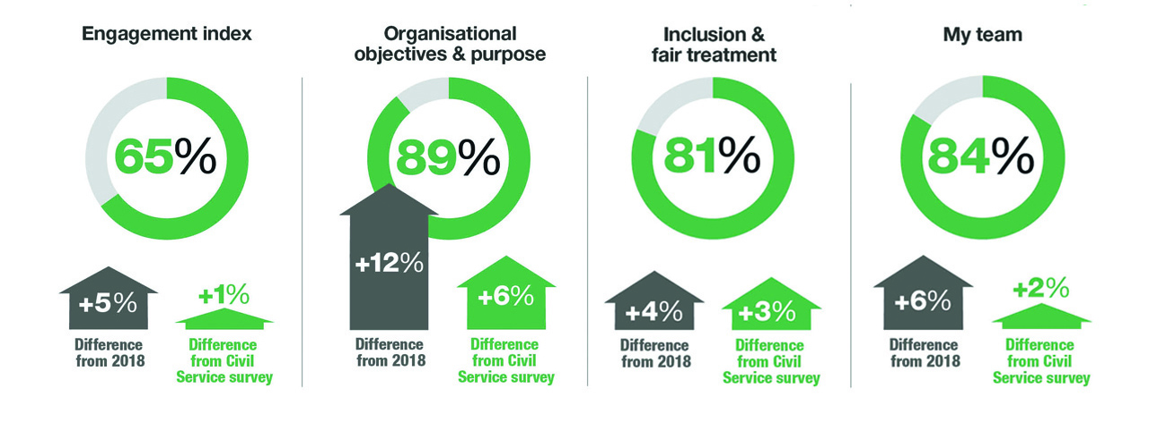
> Improving as an organisation and supporting staff
Our staff survey showed our staff were happier and more engaged:
Significant improvements in 21 categories out of a total of 30
25% improvement in some areas, bringing us in line with Civil Service high performers in certain categories

Slide 26
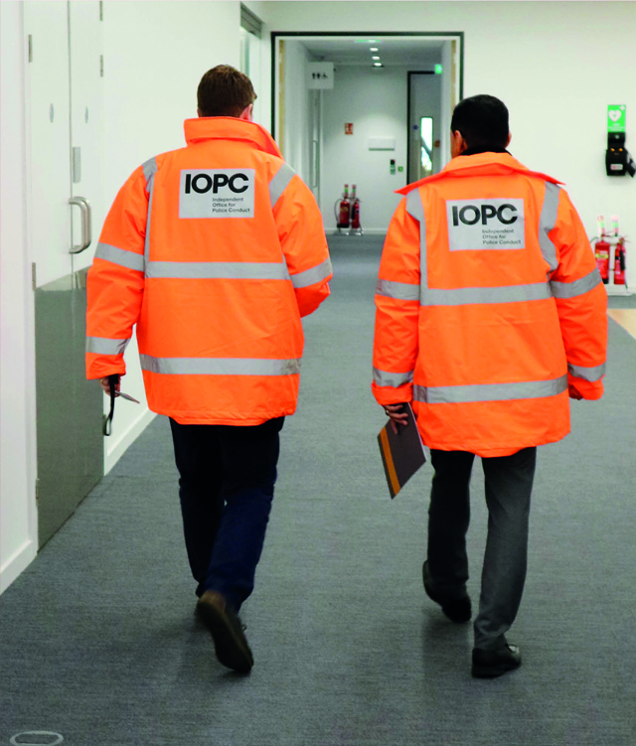
> Looking ahead
We know that we do make a positive difference, but there is still much more to do.
Our plans are ambitious, but we are determined to make further improvements in our own work and across the wider complaints system.
Central to this will be our continued focus on listening - to service users, stakeholders and others.

Slide 27
> To find out more
Website: www.policeconduct.gov.uk
Twitter: @policeconduct
Email: enquiries@policeconduct.gov.uk
Phone: 0300 020 0096
Text relay: 18001 0207 166 3000
Write to us at:
IOPC, 10 South Colonnade
Canary Wharf London E14 4PU

